Slide 1
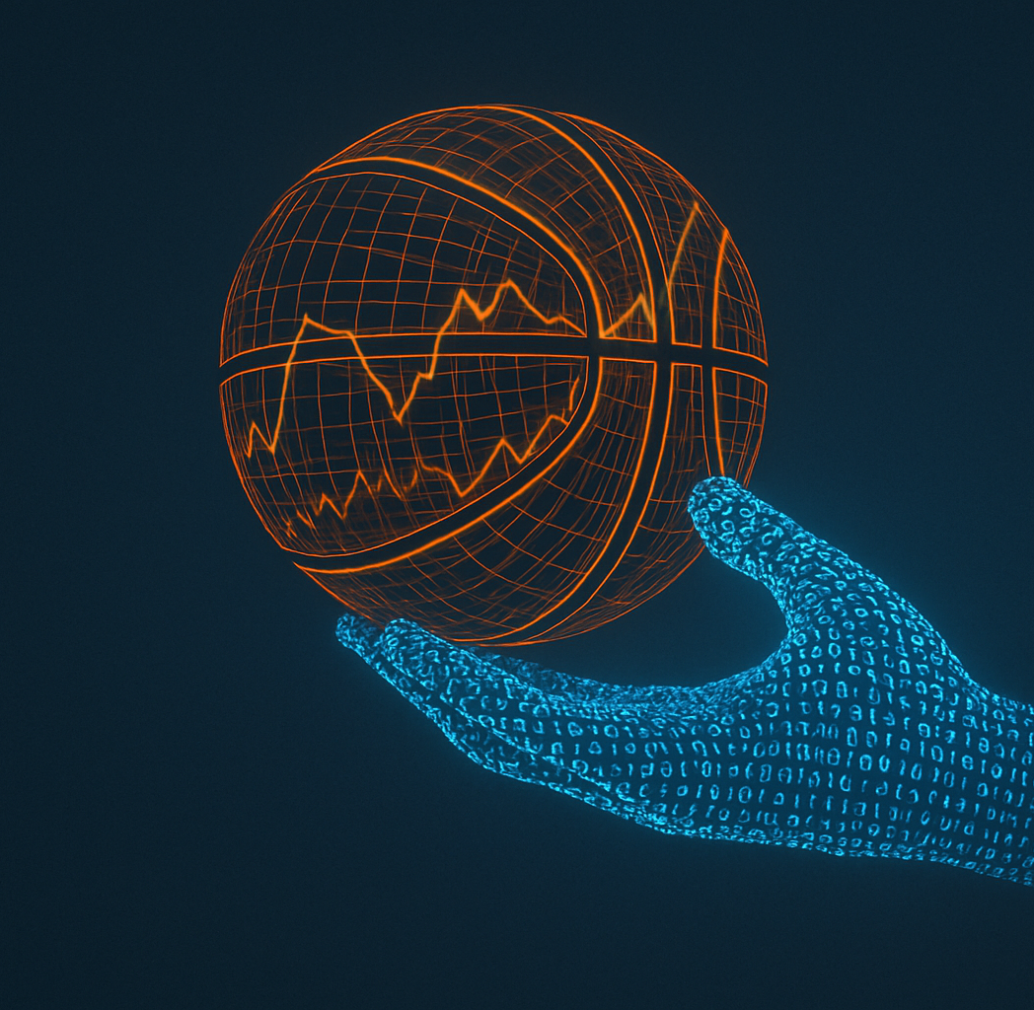
Project Title
Notes:
Image generated by chatgpt - reference

Slide 2

Meet the team
David Lynn
Alice Schulz
Jinglei Xiang
Cheng Hu
Qing Zheng

Slide 3
Stakeholders
NBA
Teams
Commercial entities (sponsors, broadcasters etc.)
Fans
Notes:
125 players from 43 countries
$76 billion TV rights
League revenue $11.3 billion
Average team value $4.4 billion
NBA (presumably) wants close games, excitement etc.

Slide 4
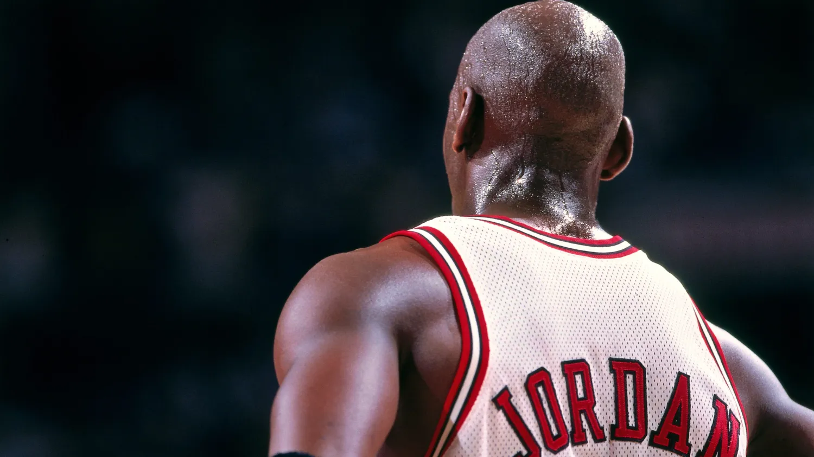
It’s better to shoot and miss, then to let time run out and wonder what if.
Image from [1]
Quote from [2]
Notes:
If riskier / further shots late in game question used.
Photo source: https://andscape.com/features/during-the-last-dance-ill-remember-how-michael-jordan-brought-me-closer-to-the-most-important-man-in-my-life/

Slide 5
Data Quality
Collection
How collected
Dataset source reliability
datasets
Missing or incomplete data
Reliability / Veracity
Relationships between datasets

Slide 6
Data Quality
COLLECTION
Datasets
Collection methods
DATASET
Missing or incomplete data
Reliability / Veracity
Relationships between datasets

Slide 7
Research Questions
Shot Success
Shot Distance
Score
Anticipated method?

Slide 8
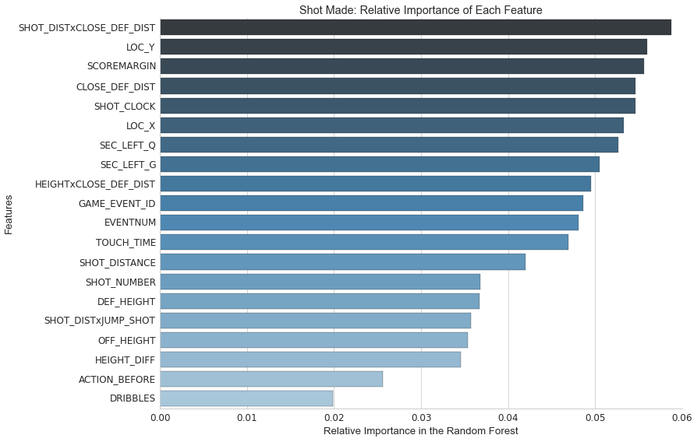
Image from [3]
Notes:
Heatmap

Slide 9
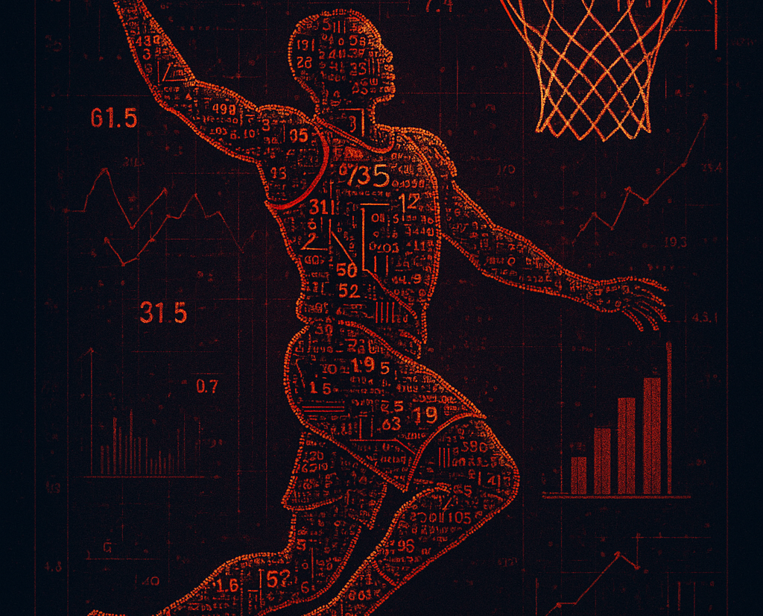
Thank you

Slide 10
References
J. Tinsley. “During ‘The Last Dance,’ I’ll remember how Michael Jordan brought me closer to the most important man in my life.” andscape.com. Accessed: August 21st 2025. [Online.] Available: https://andscape.com/features/during-the-last-dance-ill-remember-how-michael-jordan-brought-me-closer-to-the-most-important-man-in-my-life/
Basketball Mindset Training. “Top 50 Michael Jordan Quotes About Basketball and Life.” basketballmindsettraining.com . Accessed: August 21st 2025. [Online.] Available: https://www.basketballmindsettraining.com/blog/michael-jordan-quotes
J. Balbona. “NBA Shot Prediction using XGBoost.” github.com. Accessed: August 21st 2025. [Online.] Available: https://github.com/JaredBalbona/NBA-Shot-Prediction_XGBoost

Slide 11
AI Acknowledgement
AI was used to generate material in this document as detailed below
Tool | Use | Prompt(s) | Section | Date
ChatGPT | Image generation | (1) generate an image of a basketball with a single hand made of data on a plain background (2) okay how about a similar image with the basketball made of an orange vector graph, but otherwise the same as the previous | Slide #1 | 20/08/2025
 | Image generation | generate an image of a basketball slam dunk with player and ball comprised of numbers, data and graphs | Slide #9 | 20/08/2025

Slide 12
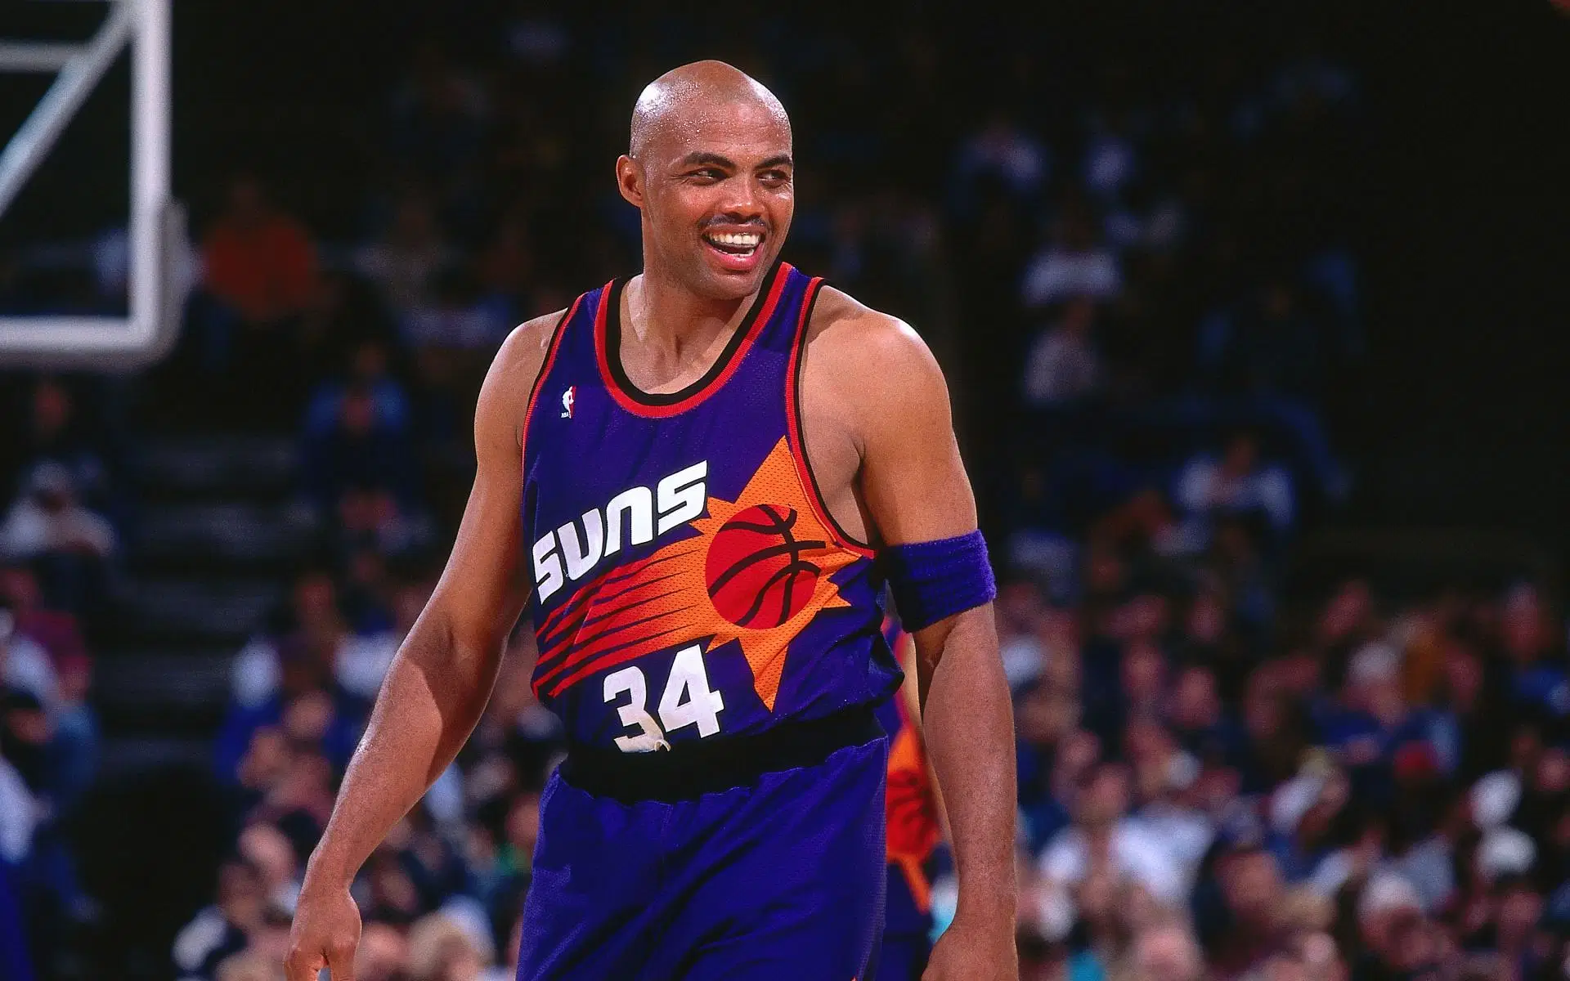
The only difference between a good shot and a bad shot is if it goes in or not
Notes:
https://www.sportskeeda.com/basketball/news-i-said-who-s-better-me-said-that-motherf-ker-right-there-charles-barkley-sick-people-telling-14-time-all-star-better

Slide 13

purpose
Introduction
Building confidence
Engaging the audience
Visual aids
Final tips & takeaways

Slide 14
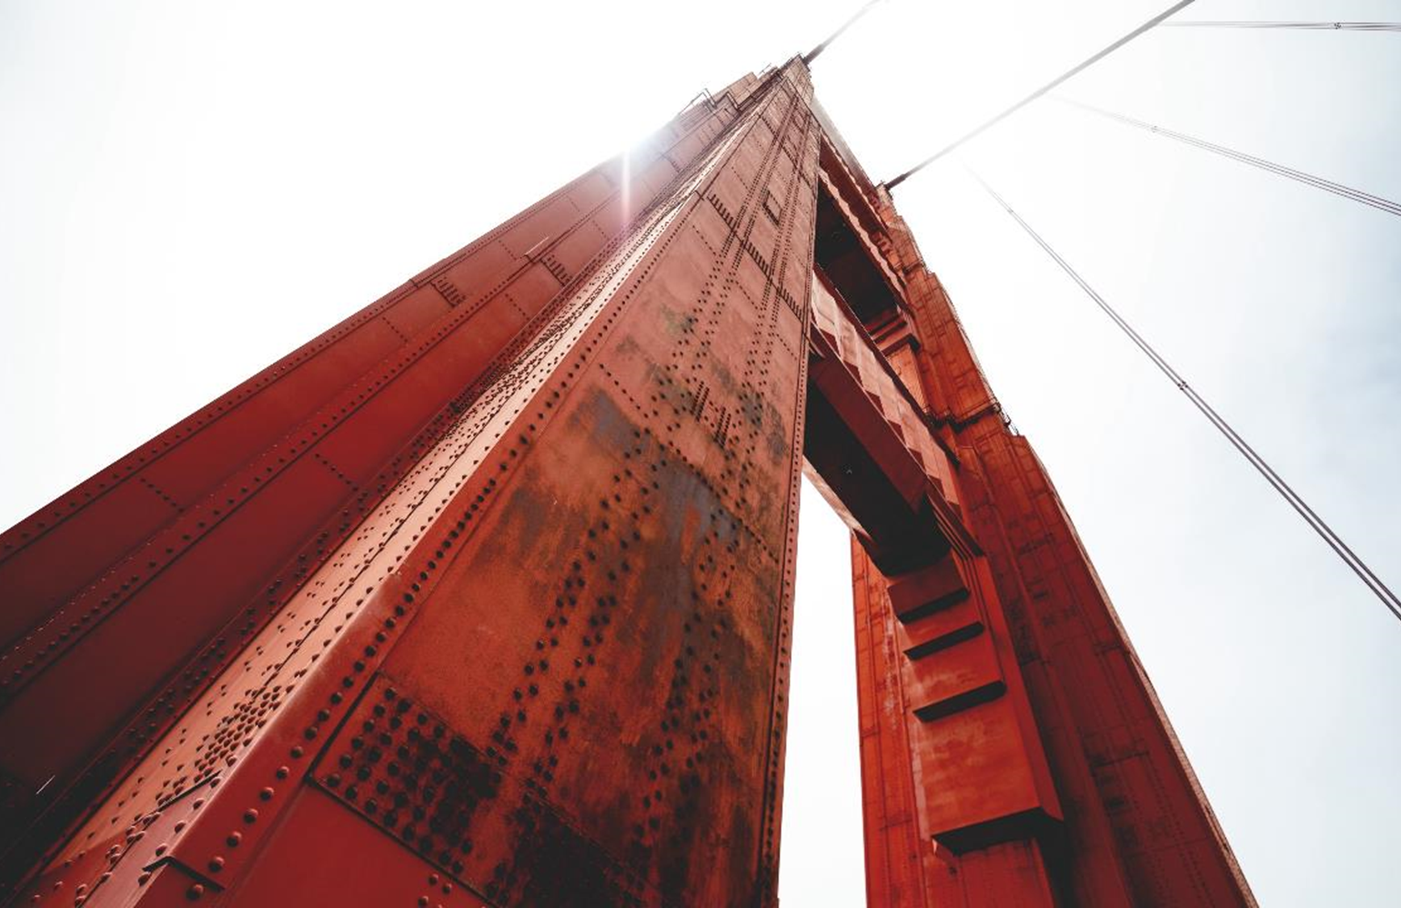
THE POWER OF COMMUNICATION

Slide 15
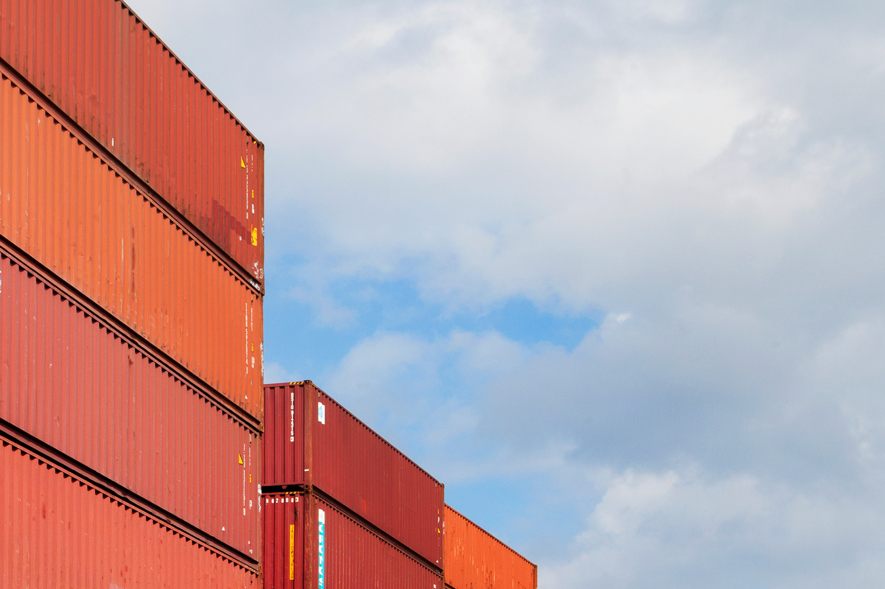
OVERCOMING NERVOUSNESS
Confidence-building strategies

Slide 16

OVERCOMING NERVOUSNESS
Techniques for connecting
Make eye contact with your audience to create a sense of intimacy and involvement
Weave relatable stories into your presentation using narratives that make your message memorable and impactful
Encourage questions and provide thoughtful responses to enhance audience participation
Use live polls or surveys to gather audience opinions, promoting engagement

Slide 17
OVERCOMING NERVOUSNESS
Confidence-building strategies

Slide 18
Final tips & takeaways
Continue improving
Seek feedback
Reflect on performance
Explore new techniques
Set personal goals
Iterate and adapt
PRACTICE MAKES PERFECT
Consistent rehearsal
Strengthen your familiarity
Refine delivery style
Pacing, tone, and emphasis
Timing and transitions
Aim for seamless, professional delivery
Practice audience

